Slide 1
Chicago Business Intelligence for Strategic Planning Demo
MSDS 432 Group 3
Jun Wu, (Claire) Mingming Gu, Andrew Gray
03/12/2023

Slide 2
Using Taxi Trip and Current Covid case to forecast the future spreading Zipcode

Slide 3
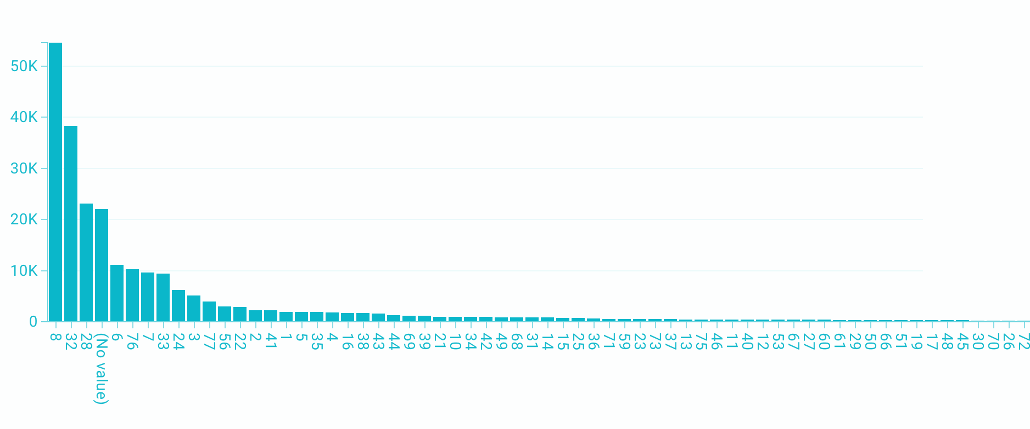
Taxi trip 02/15/23 to now VS Zipcode Pickup Community Area

Slide 4
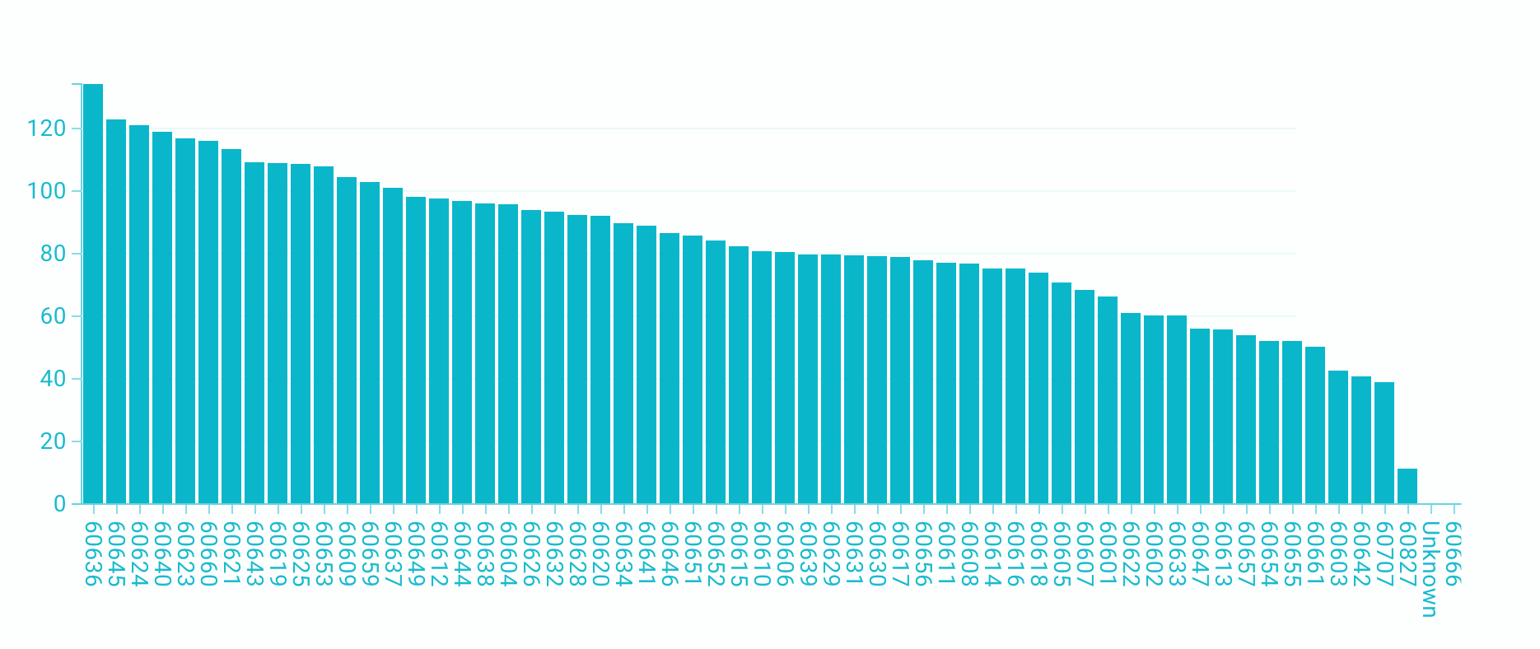
Weekly Average from 02/01/23 to now Covid case VS Zipcode

Slide 5
Mapping Community Area to Zipcode
If Pickup areas has high covid case, then the dropoff location most likely would have high spread in next few weeks

Slide 6
Using Taxi Trip and Airports as a pickup location to forecast the future spreading Community Area / Zipcode

Slide 7
O’Hare Airport:
60018 Latitude:Longitude (41.978611,-87.904724) Community area: 76
Midway Airport:
60438 Latitude:Longitude (41.7868,-87.7522) Community area:56
Taxi trip community area or (Latitude:Longitude )=> Zipcode
*Using the google API unique (Latitude:Longitude ) => zipcode table create from HW#1 & HW#2

Slide 8
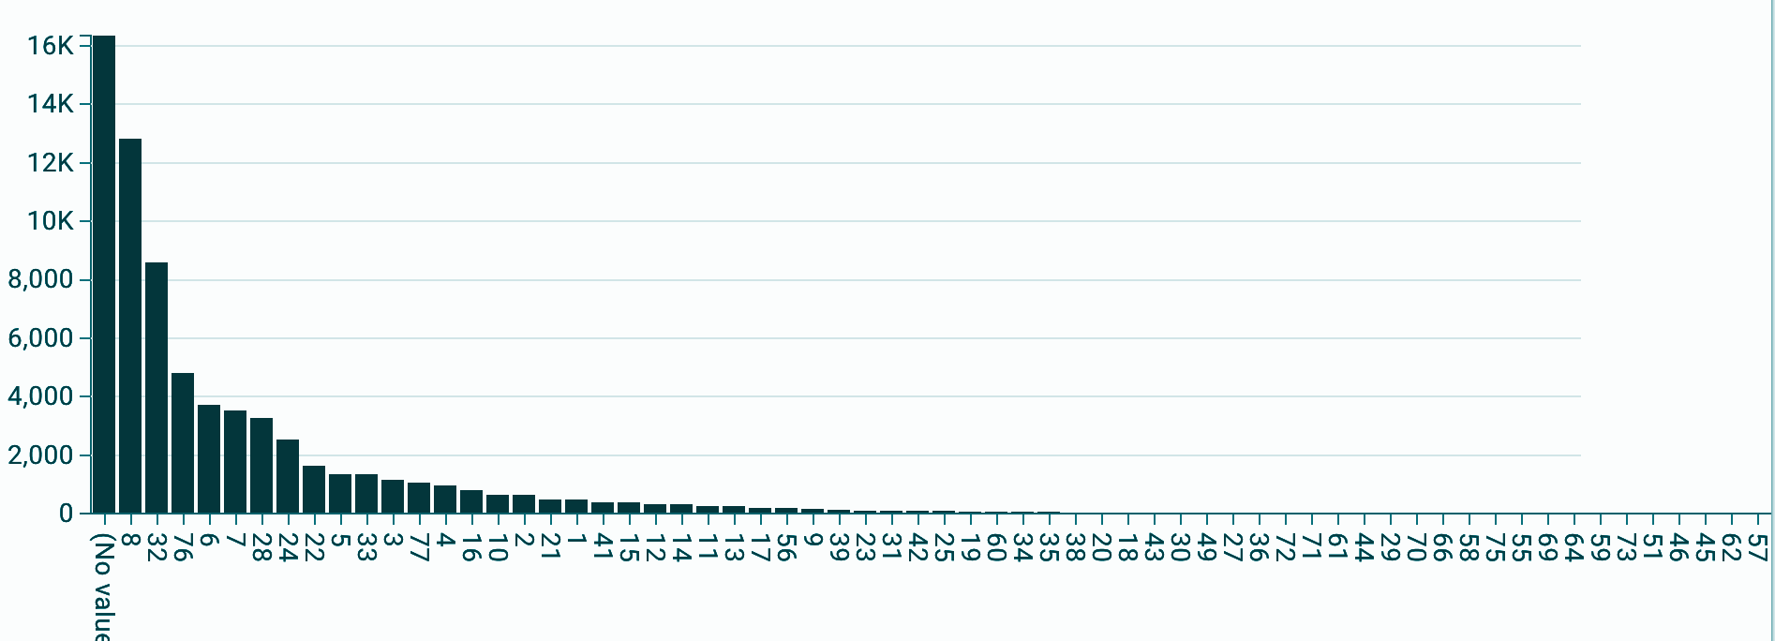
O’Hare Airport:
60018 Latitude:Longitude (41.978611,-87.904724) Community area: 76
# of Trip from O’Hare Airport to other community areas location from Feb. 2023

Slide 9
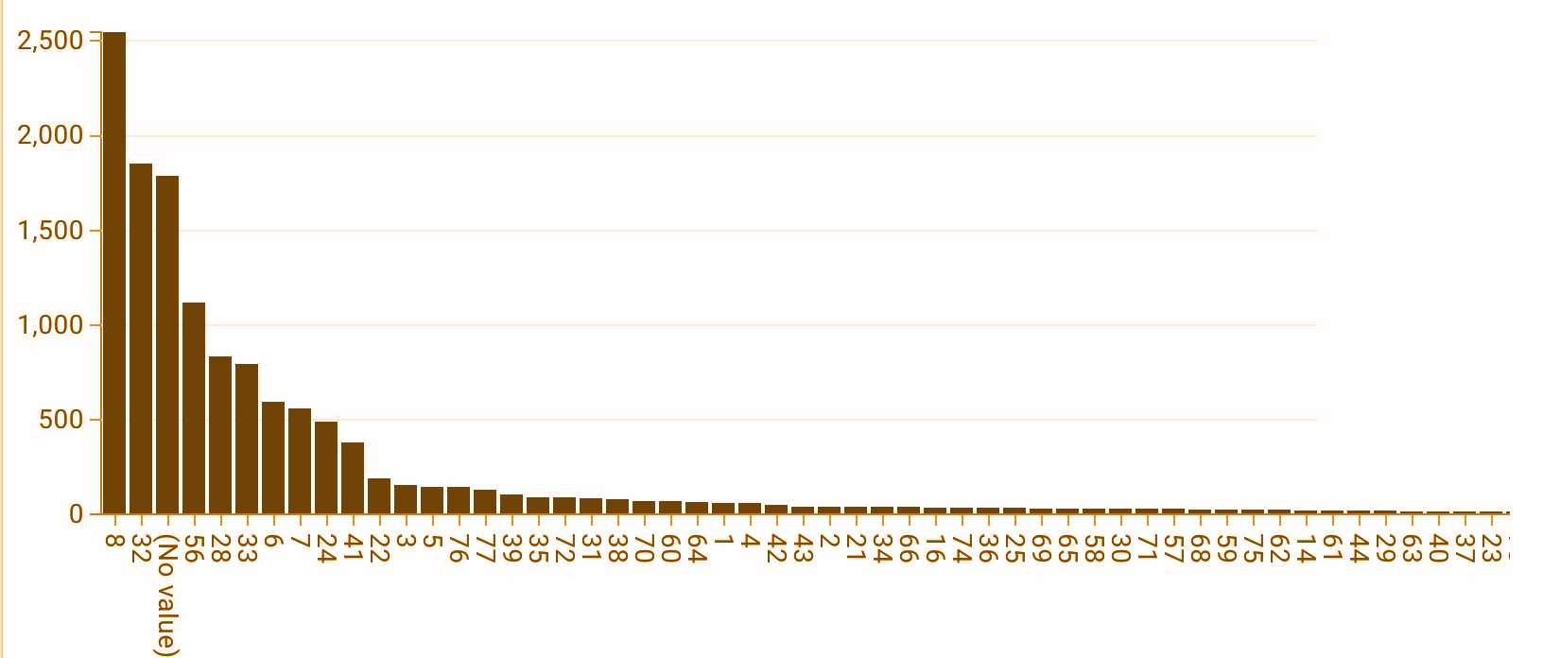
Midway Airport:
60438 Latitude:Longitude (41.7868,-87.7522) Community area:56
# of Trip from Midway Airport to other community area location from Feb. 2023

Slide 10
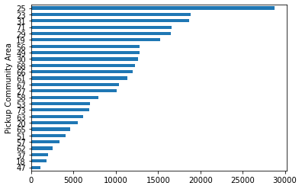
Requirement 3: Track Number of Taxi Trips from/to the Neighborhoods with High CCVI

Slide 11
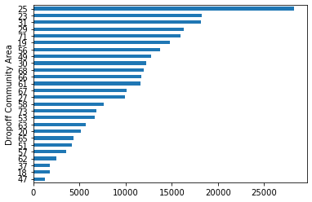
Requirement 3: Track Number of Taxi Trips from/to the Neighborhoods with High CCVI
Note: It highly resembles with the earlier chat but not the same! Here, Community Area 70 > 63

Slide 12
Requirement 4: Daily/Weekly Forecast of Taxi Trips per Community Area
This is an animated chart showing data from 11/01/2020 to 11/07/2020.

Slide 13
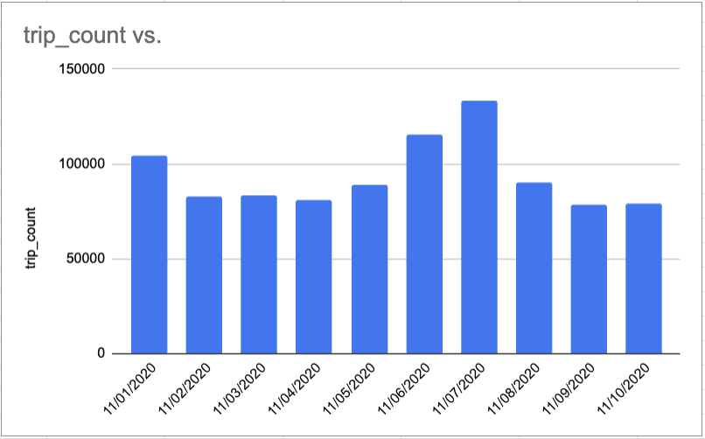
Requirement 4: Daily Counts of Taxi Trips in Total

Slide 14
Requirement 4: Daily/Weekly Forecast of Taxi Trips per Community Area

Slide 15
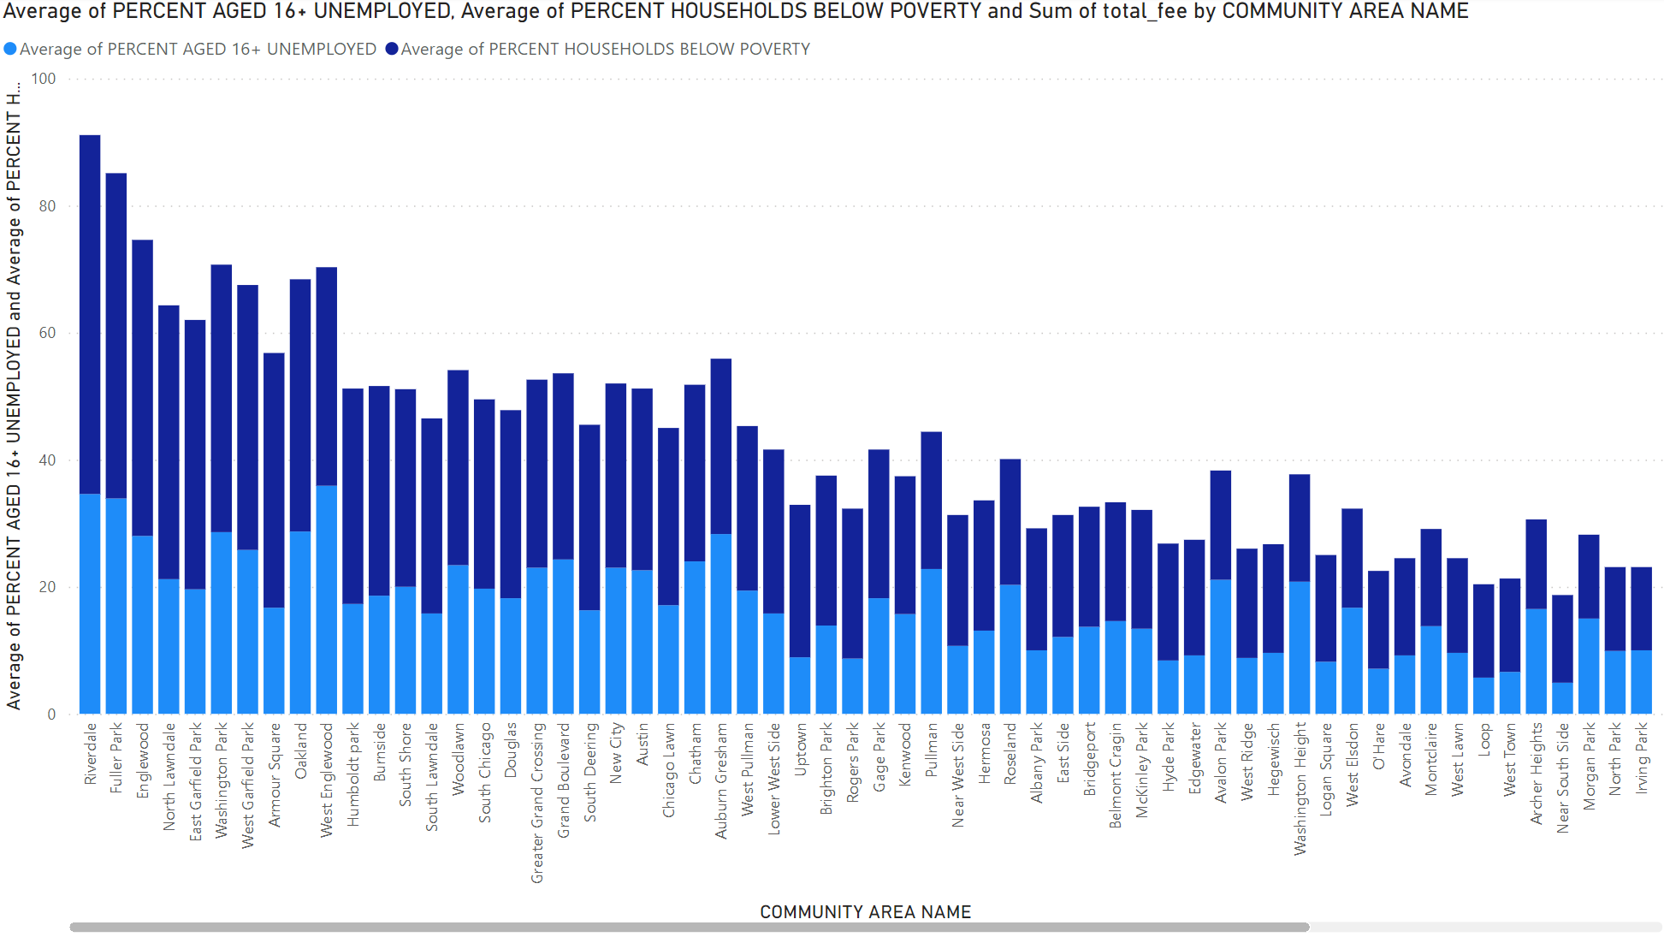
Requirement 5: Neighborhoods with Highest Unemployment and poverty rate.

Slide 16
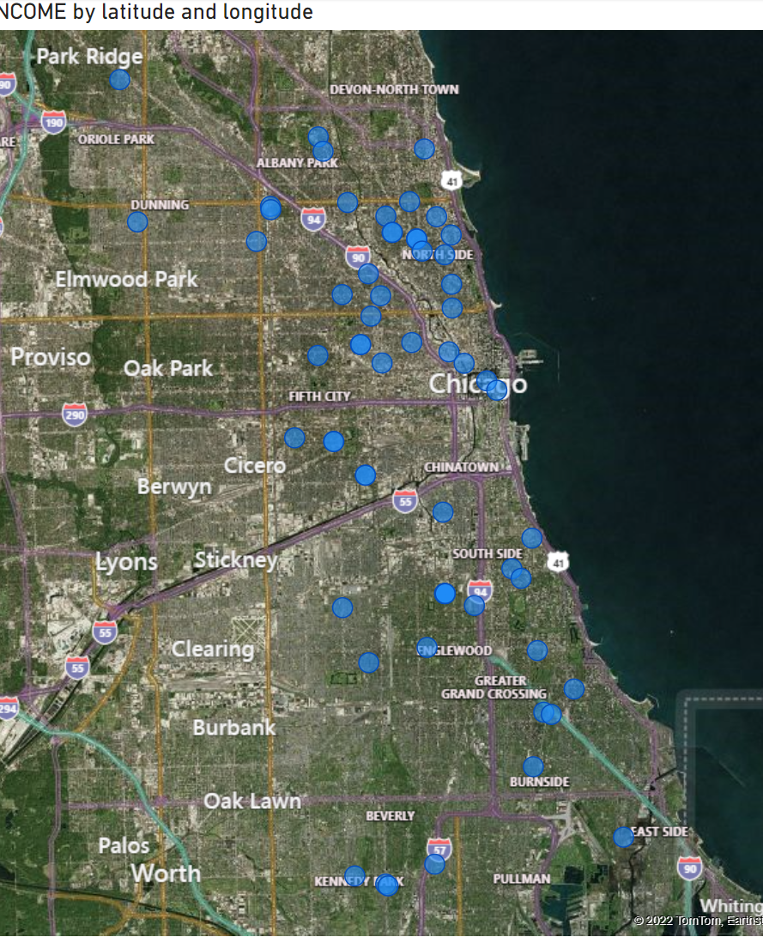
Requirement 6: New construction permits by Community Area below 30000 in annual income.

